Slide 1
#53
Enabling Energy Data for Applications

Slide 2
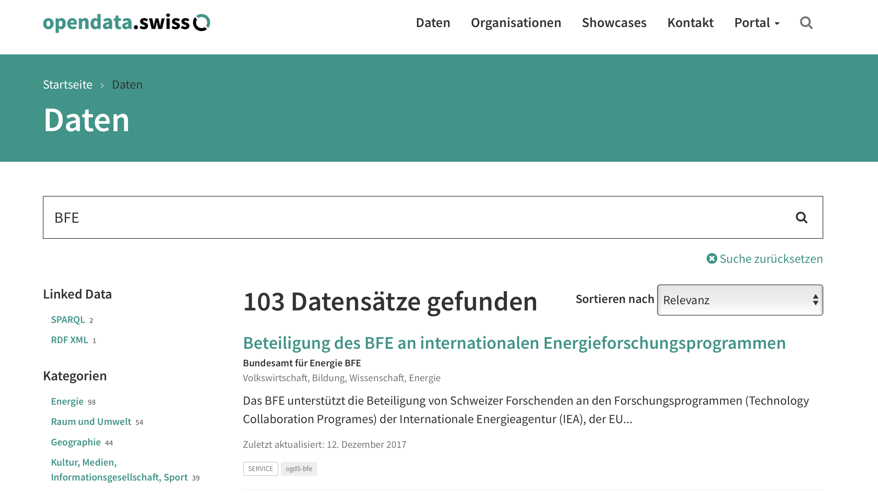

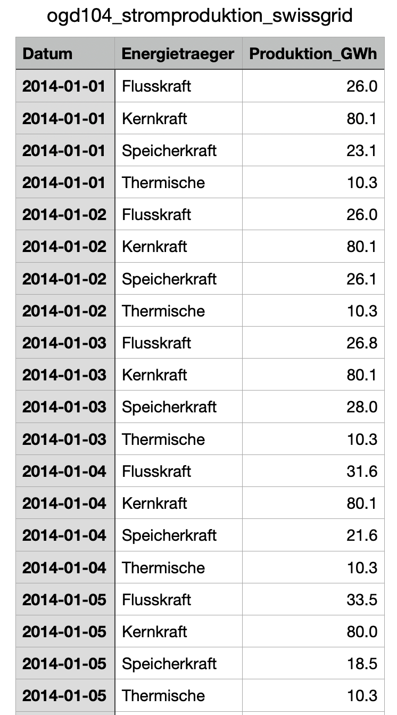
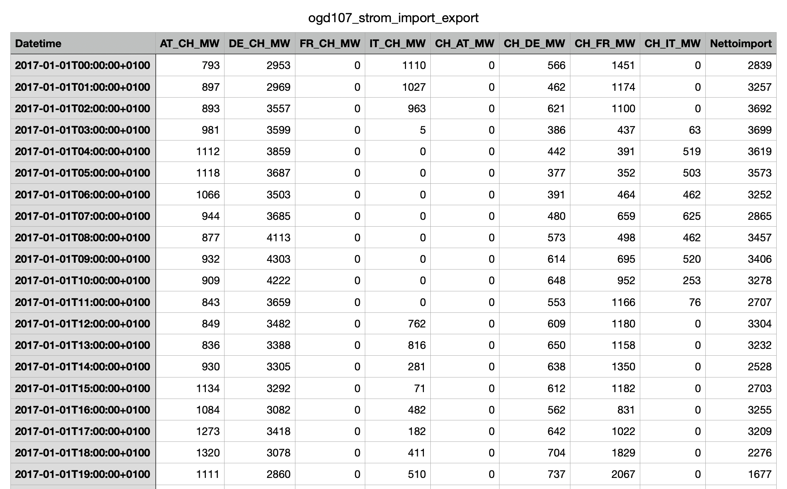
Current Pain Points
Difficult to find relevant information
Handling issues
production
Download full files
import
Tons of csv files…
…
Tons of csv files…

Slide 3
Current Pain Points
Difficult to find relevant information
Handling issues
Download full files

Slide 4
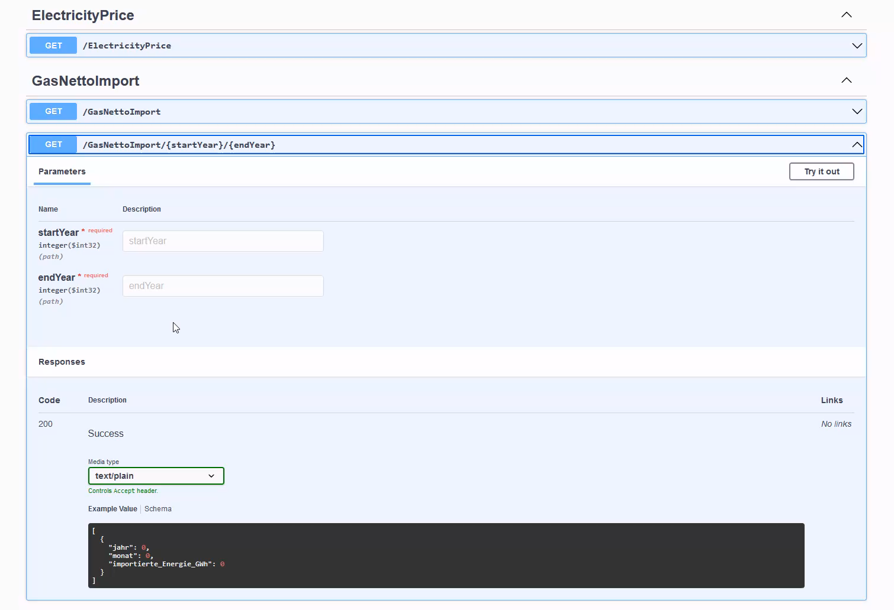
Solution Demo

Slide 5
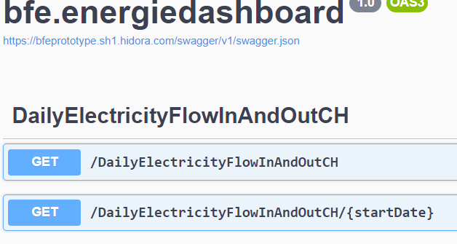
How does it work?
API
😊
API
csv
csv
😐
API
SUPER - API
Swagger
API
csv
Aggregator
csv
API
csv
API
csv
API
csv

Slide 6
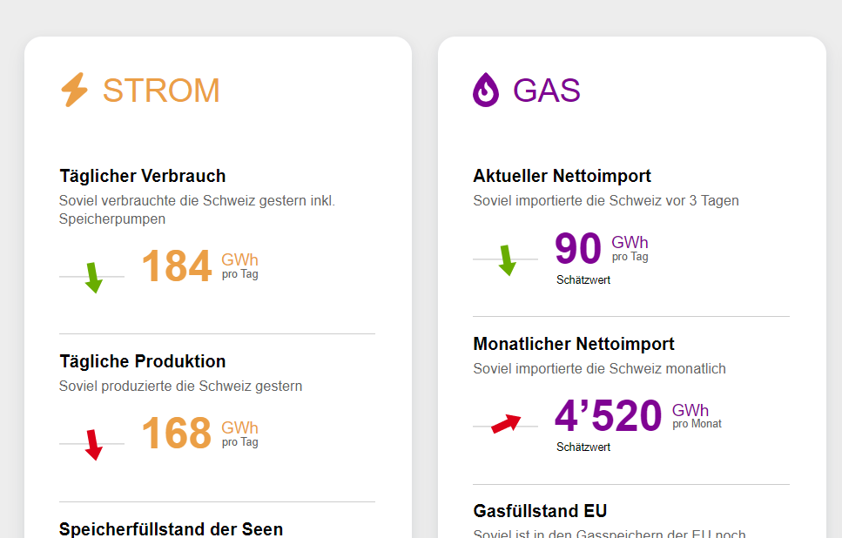

Added Value
SCALABILITY
USER EMPOWERMENT
csv
csv
csv
«Energy Dashboard for everybody»

Slide 7

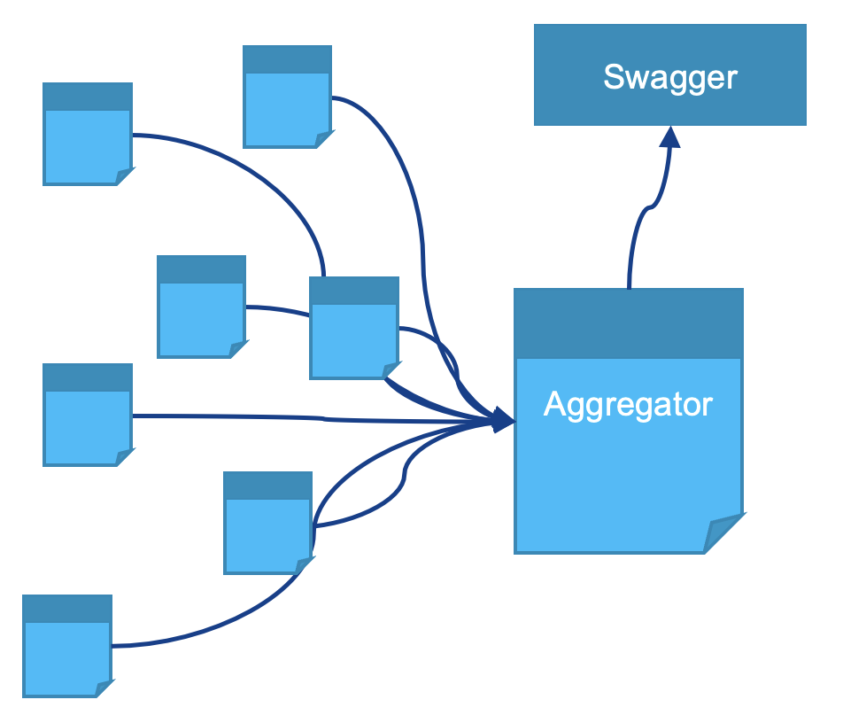
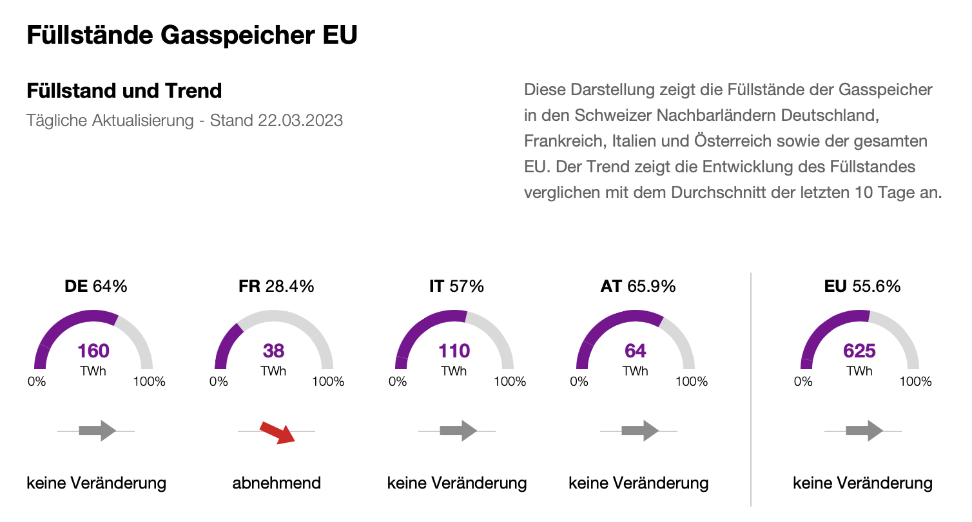
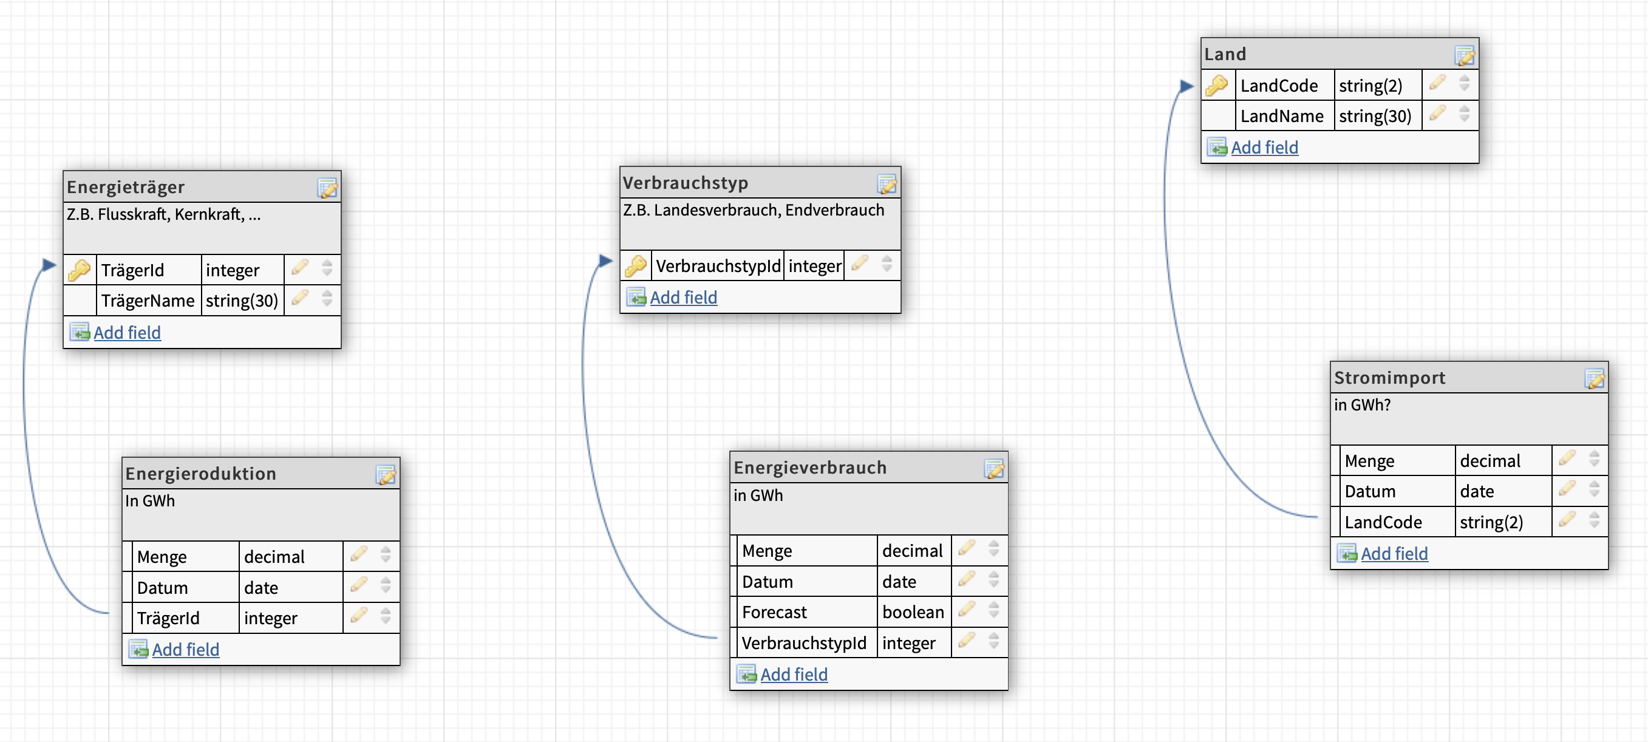
Next Steps
“Super-API” POC
Standardized naming
Dashboard builder
☑︎
❎
❎

Slide 8

Our great team
Corinne Straub
Gabriel Wyss
Helmut Recher
Roby Radica
Lucas Tochtermann
Peter Janes
Daniele Scopece
Notes:
BSp Daten
Bsp Use Case wer kann was damit machen
Bsp Whats next.

